Slide 1

Welcome to let’s donate
Giving is not just about make a Donation It's About Making a DIFFERENCE

Slide 2
Donation
Education
Health Consultation
Blood Donation
Food
Cloth

Slide 3
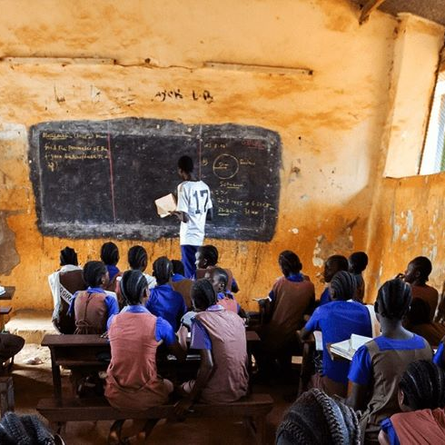
Introduction
Thank you for visiting Let’s Donate. We are a platform that aims to create positive change in the world by empowering individuals to make a difference through charitable donations. Our mission is to connect generous donors like you with reputable charitable organizations and causes in need. With your support, we can help create a better world for those who need it most.

Slide 4
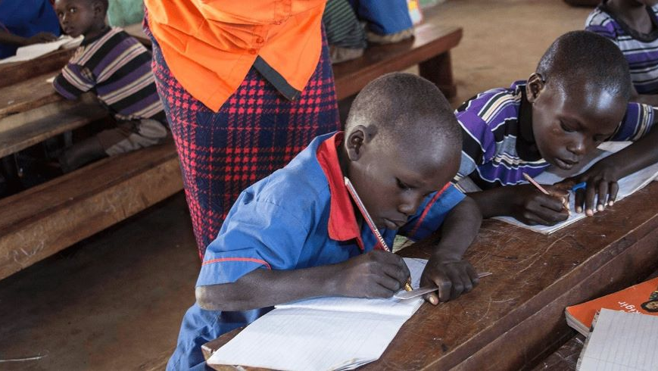
Empowering Education for All
At Let’s Donate, we believe that education is a fundamental right that should be accessible to all, regardless of their financial circumstances. We are committed to providing free education to those in need, empowering individuals to break the cycle of poverty and create a brighter future for themselves and their communities

Slide 5
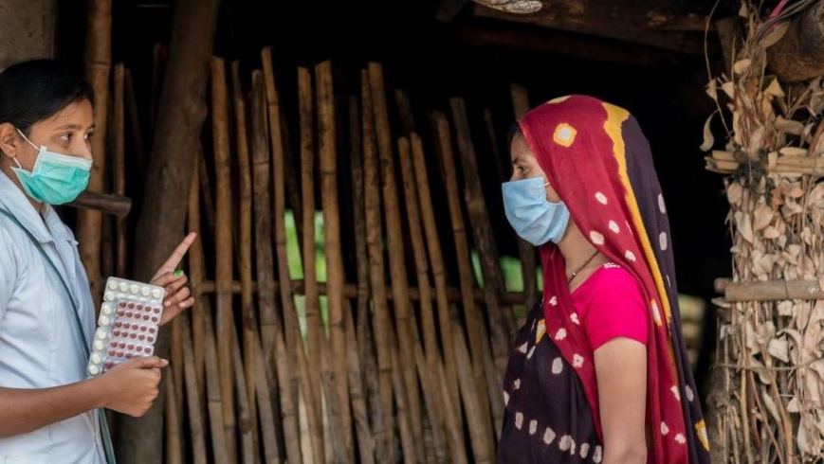
Your Health Matters: Free Health Consultation for a Better You
The idea of the free health consultation presentation is to provide valuable information and guidance to individuals seeking to improve their health and well-being. The presentation could cover various aspects of health, such as nutrition, exercise, mental health, and preventive care. It may also include information on common health concerns, tips for maintaining a healthy lifestyle, and practical advice for managing health-related challenges. The goal is to empower the audience with knowledge and tools to make informed decisions about their health and ultimately lead a healthier life.

Slide 6

LifeSaver: The Gift of Blood Donation
Blood donation is a vital act of generosity that saves lives and improves the health of patients in need. This title emphasizes the life-saving impact of blood donation, while also highlighting the selfless nature of donors who provide the gift of life to those in need. The concept of "LifeSaver" conveys the powerful impact of blood donation on individuals and communities, and the title "The Gift of Blood Donation"

Slide 7

Nourish and Thrive: The Power of Food Donation
Food donation plays a crucial role in alleviating hunger and promoting well-being in communities. The title "Nourish and Thrive" conveys the idea that food donation not only provides sustenance, but also empowers individuals and communities to thrive. It emphasizes the importance of access to nutritious food for overall health and well-being. The subtitle "The Power of Food Donation" highlights the transformative impact that food donation can have on vulnerable populations, while also recognizing the generosity of donors who contribute to this cause.

Slide 8
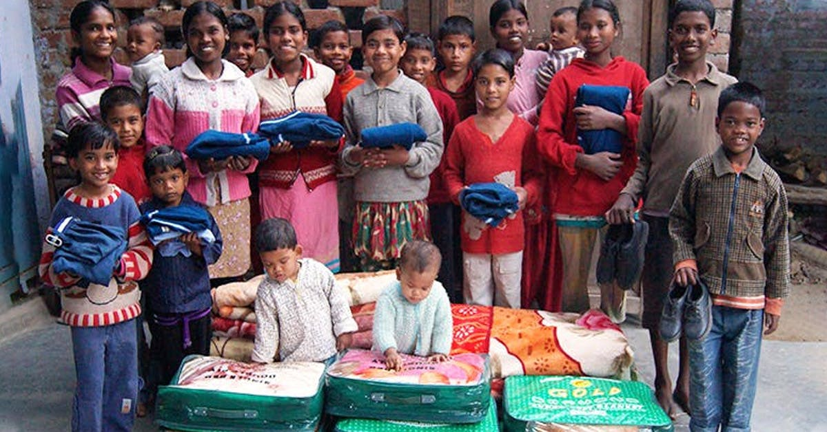
Clothe with Care: The Gift of Clothing Donation
Clothing donation is a compassionate act that provides warmth, dignity, and comfort to those in need. The title "Clothe with Care" conveys the idea that clothing donation is not just about providing clothes, but also about showing care and empathy towards individuals facing clothing insecurity. It emphasizes the importance of clothing as a basic human need and the impact that donated clothing can have on the lives of those who receive it.

Slide 9




Bro code
Akhand Pratap singh
Deepak Verma
Vibhav Yadav
Suraj Sachan

Slide 10




Thank you
Deepak Verma
dvverma9211@gmail.com
Let’s Donate

